Slide 1

Leading the Agriculture 4.0 Revolution
AgroBots
Terrain Management as a Service for Sustainable Productivity
Notes:
- Welcome the audience and introduce the Agrobots project.
- Explain the concept of Agriculture 4.0 – using AI, robotics, and big data for smarter, more efficient farming.
- Present Agrobots as offering 'Terrain Management as a Service'.
- State the mission: produce what’s needed, when it’s needed, in the most sustainable and efficient way.

Slide 2

Challenges of Modern Agriculture
SOARING DEMAND
LABOR SHORTAGES
ENVIRONMENT DEGRADATION
INCREASED MARKET RISKS
Notes:
- Challenge 1 – Soaring demand: due to a growing, urbanized population with longer lifespans and higher consumption.
- Challenge 2 – Environmental degradation: over-reliance on fertilizers, diesel, and unsustainable methods degrading soil and ecosystems.
- Challenge 3 – Labor shortages: demographic trends show generational decline in agricultural workers (personal family example).
- Challenge 4 – Market risks: globalized food chains are fragile and vulnerable to disruptions (e.g., Suez Canal blockage, geopolitical events).
- State the need for local autonomy and resilience in food systems.

Slide 3
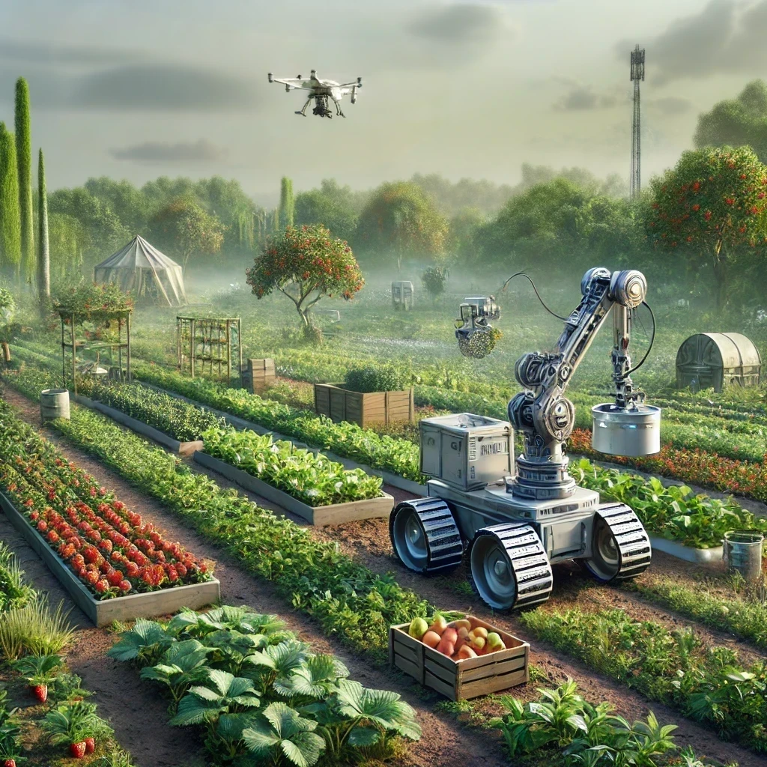
Bioromes
Bio-Robotic
Modular
Ecosystems
The farm as an AI-driven ecosystem
High Resolution Monitoring
Robotic modules integration
Adaptable to changing conditions and purposes
Notes:
- Introduce 'Bioromes': bio-robotic modular ecosystems.
- Shift the mindset: farms should be integrated ecosystems, not monocultures.
- Use high-resolution monitoring (down to plant/square meter level) to manage land.
- Embed monofunctional robotic modules as ecosystem participants—not just tools—to adapt to changing conditions.
- Use emergent patterns from nature and tech to drive productivity.

Slide 4
Optimization Engine (AI)
Analyzes all interactions within the biorome and builds a predictive model to optimize operations.
Operations Engine (IoT Control)
Executes field operations by managing robotic modules and implementing the AI’s parameters.
Operational parameters for automated field execution
Land OS
Unified Terrain Management Platform
Analytics Engine (Hybrid Data Layer)
Aggregates and normalizes data from biorome sensors, external sources (market, weather, regulations), and ecosystem engineers' inputs.
Processed data and expert inputs
System status and field data
Notes:
- Introduce LandOS – the unified terrain management platform that powers bioromes.
- Three key components:
- - Optimization Engine: uses AI and predictive models to define optimal states and operational parameters.
- - Operations Engine: executes these parameters via coordinated robotic tasks in the field.
- - Analytics Engine: collects and processes data from the field, other bioromes, and external sources (weather, regulations, market).
- Highlight the hybrid nature of the analytics engine – combining big data with expert human inputs.

Slide 5
Terrain Management as a Service
Delivery Lifecycle
Design
Deploy
Operate
Optimize
Notes:
- Outline the bio-rural transformation journey:
- - Design: initial monitoring and analysis to build the right ecosystem for the land and production goals.
- - Deploy: introduce robotic modules with minimal disruption.
- - Operate: reach full operational capacity with data flowing back into the system.
- - Optimize: system becomes increasingly efficient over time thanks to feedback loops.

Slide 6

Monetization & Business Model
Terrain Management as a Service
Agrobots monetizes through Terrain Management as a Service (TMaaS), offering multi-year contracts based on full-scope biorome management via the LandOS platform.
Agricultural Production
Core business model focused on long-term agricultural optimization.
Recurring revenue through annual terrain management fees.
Fixed-rate pricing per hectare, providing predictable budgeting for customers.
Additional Services for Expansion
Adaptable to brownfield remediation or ecological monitoring.
Enables entry into broader markets with varying operational intensity.
Scalable growth leveraging the same underlying technology platform.
Performance-Based Approach
KPIs tailored per client, including productivity, soil health, or ecological stability.
Validate operational success and secure contract renewals, without exposing us to the volatilities of the commodities market.
Notes:
- Monetization model: 'Farming as a Service'.
- Target customers: large agribusinesses, landowners, and cooperatives—not smallholder farmers.
- Revenue through recurring terrain management fees.
- Offer specialized modules for additional services: ecological monitoring, wildfire prevention, and brownfield remediation.
- Pricing is performance-based, tied to clear, measurable KPIs.

Slide 7
Pricing Strategy
Agrobots' TMaaS pricing strategy is structured around fixed-rate, multi-year contracts, clearly aligned with the operational intensity and objectives of each deployment. This approach ensures predictable budgeting for clients while demonstrating measurable value over time.
Client-specific KPIs ensure transparent impact measurement and validate long-term partnership value, maintaining fixed pricing independent of external market fluctuations.
Average Annual Intensive Agriculture Operations Costs per Hectare
Irrigation & water: €280 - €400
Terrain Management as a Service
Total €4,500 - €5,200
+15–40% productivity
All operational costs included in fixed fee
Varies with deployment intensity
Fuel & machinery: €800 - €2400
Labor: €2,900 - €4,130
Fertilizer & Other Chemicals: €150 - €200
Others (seeds, soil enrichment, vet, tools, etc): €300 - €800
Total: €4430 - €7930
Based on average operational cost ranges in advanced agricultural economies (ES, NL, US).
Notes:
- Monetization model: 'Farming as a Service'.
- Target customers: large agribusinesses, landowners, and cooperatives—not smallholder farmers.
- Revenue through recurring terrain management fees.
- Offer specialized modules for additional services: ecological monitoring, wildfire prevention, and brownfield remediation.
- Pricing is performance-based, tied to clear, measurable KPIs.

Slide 8
Go-to-Market & Initial Customer Focus
Smart entry through high-need, cost-sensitive operators in European agriculture
Ideal Customer Profile
Mid-to-large agri-corporations and cooperatives (100+ ha)
Located in Spain, France, and the Netherlands
Face rising input costs, labor shortages, and operational pressure
Operate traditional mechanized systems; no exposure to terrain-as-a-service
Manage monoculture or low-diversity crops with limited operational flexibility
Seeking to reduce operational expenses and tap into sustainability-linked incentives
Final decision-maker: Operations or production manager
Entry Strategy
Launch field deployment in Guatemala (available 160 ha pilot site)
Leverage pilot to refine offering and showcase system maturity
Target 2–3 anchor customers in Europe with early adopter benefits
Align with grant or subsidy programs to reduce entry risk for clients
Go-to-Market Channels
Direct outreach to operations leads at major producers
Partner with OEMs and agtech resellers for credibility and reach
Engage government programs and NGOs in sustainability, biodiversity, and land remediation
Notes:
- Monetization model: 'Farming as a Service'.
- Target customers: large agribusinesses, landowners, and cooperatives—not smallholder farmers.
- Revenue through recurring terrain management fees.
- Offer specialized modules for additional services: ecological monitoring, wildfire prevention, and brownfield remediation.
- Pricing is performance-based, tied to clear, measurable KPIs.

Slide 9
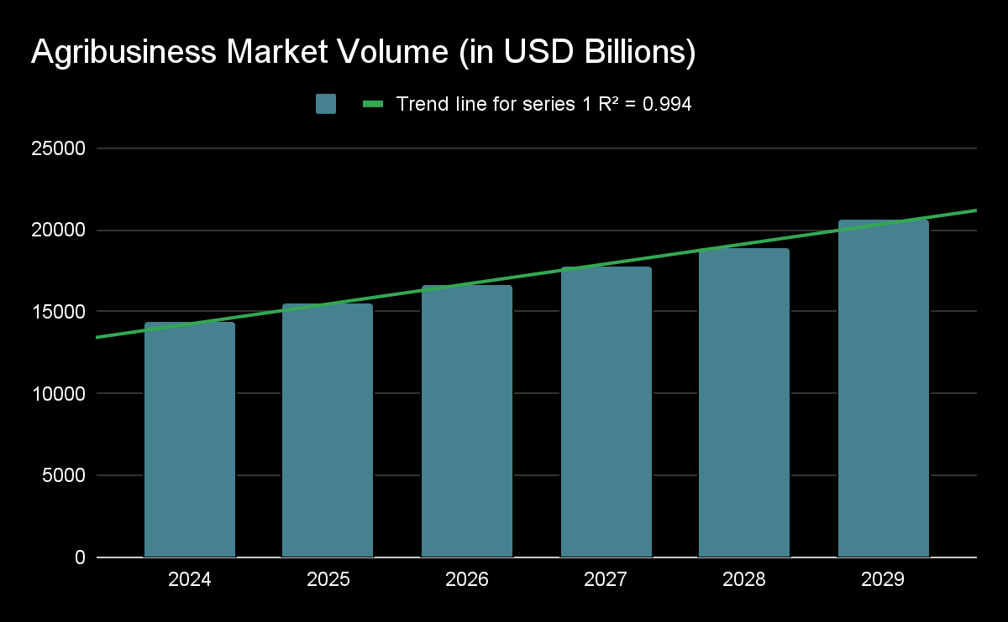
Market Opportunity
Structural transformation in Agriculture
Automation
Sustainability
Traceability
Our modular platform captures value
On-site production and processing
Automation and robotics
Transport and Warehousing
Input reduction and efficiency gains
Global agri-food value chain projected to surpass $20T by 2029
We target high-value, intensive-use agricultural land and infrastructure management, a ~€100B+ opportunity across key regions in the Americas and Europe.
TAM - €20T
Agri-food global value chain
SAM - €250B
Addressable terrain & productivity market in target regions
SOM - €1.2B
Realistic share of early adopter + scale-up markets
Notes:
- Massive market opportunity: $20T global agri-food value chain projected by 2029.
- Market forces pushing transformation: need for automation, sustainability, and traceability.
- Agrobots can capture value across the chain: on-site production, automation, transport/logistics, and input reduction.
- Advantage: fewer inputs, better data, and localized processing reduce overall costs and environmental footprint.

Slide 10
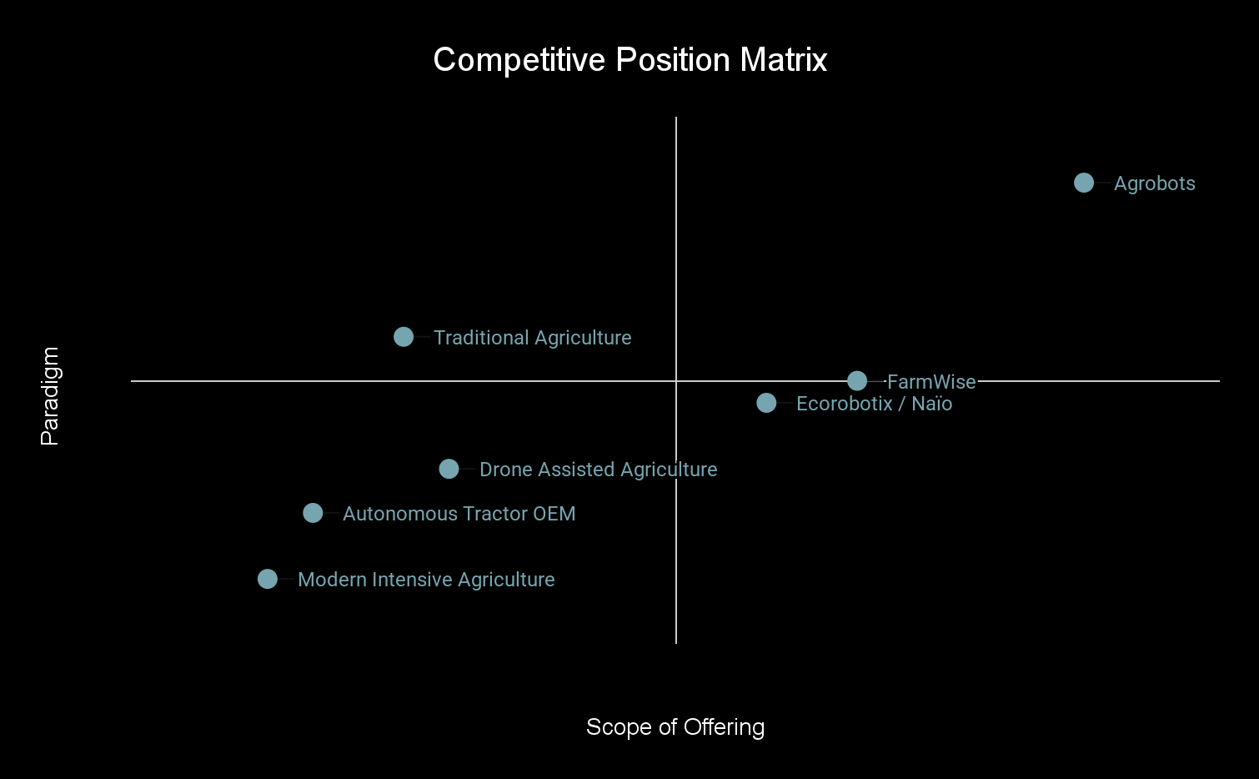
Competitive Landscape
Competitors: Autonomous tractors, drone-managed monocultures
Integrative
Common approach: Replace human labor, same methods
Paradigm shift: From extractive to integrative productivity
Extractive
Our difference: Small robots, integrative ecosystems
Tool
Platform
Notes:
- Position Agrobots in the competitive landscape.
- Current competitors: autonomous tractors, drone monocultures – still using extractive models.
- Other startups (e.g., EcoRobotics) provide tools, but not ecosystems.
- Agrobots offers an integrative, system-level platform with small robots managing natural-scale interactions.
- We’re not just replacing labor; we’re rethinking the method entirely.

Slide 11
Defensible by Design
Built for resilience — in both production and markets
Mission-Aligned Founding Team
We bring hands-on agricultural experience, technical leadership, and industrial ecosystem strategy — a rare combination that anchors both credibility and execution from day one.
Integrated Ecosystem Engineering
Our bioromes combine plant, animal, and terrain intelligence into unified, programmable environments. This cross-domain integration is technically complex and not easily replicated by vertical-only solutions.
Modular Tech with Field-Driven Learning
LandOS and our adaptive robotics stack adjust to local terrain and missions. Each deployment generates proprietary operational data, continuously improving efficiency and environmental outcomes.
Notes:
- Position Agrobots in the competitive landscape.
- Current competitors: autonomous tractors, drone monocultures – still using extractive models.
- Other startups (e.g., EcoRobotics) provide tools, but not ecosystems.
- Agrobots offers an integrative, system-level platform with small robots managing natural-scale interactions.
- We’re not just replacing labor; we’re rethinking the method entirely.

Slide 12
Early Traction and Partnerships
ACES Consortium
We have established formal relationships with several companies from around the world to co-develop an IoT interconnection standard
Award Recognition
European AI Innovation Awards 2025
Guatemala Chamber of Commerce Tech Challenge 2023
Dubai Prototype for Humanity 2026
Project Partnership
Partnering with several world-renowned institutions to develop ecological monitoring and agricultural sustainability projects in several locations via EU tenders.
Pilot Farm Secured
Confirmed access to a 163 ha farm for
full-scale pilot implementation in Guatemala.
Notes:
- Early traction includes:
- - Access to a 163 ha pilot farm in Guatemala (half forested, great for testing).
- - Awarded 3rd place in Guatemala’s Tech Challenge, sponsored by Microsoft.
- - Partnership with drone-maker Dronak to co-develop module-drone connectors; use of drones for free during the pilot.

Slide 13

Funding and Investment
Seed Round Funding Target:
€2.47M
Use of Funds:
Technology & Platform Development
Pilot Deployments & Operational Setup
Team Expansion & Market Entry
Full breakdown in annex. Funds are aligned with milestones in our strategic roadmap (next slide)
Why Invest Now?
Strategic timing: tech, policy, and climate urgency align
Scalable TMaaS model with high-margin potential
Pilot site secured + OEM integration underway
Lean founding team with deep field access
Per-hectare pricing model already benchmarked to replace costs
Notes:
- Seeking €2.36M in seed funding.
- Use of funds: platform development, pilot deployments, team expansion.
- Why now?
- - Market is ripe for disruption.
- - We have proven partnerships and initial traction.
- - The model is scalable and has a clear path to profitability.
- - Waiting risks losing first-mover advantage.

Slide 14
Strategic Roadmap
MVP Build
Timeframe: 0–12 months
Focus:
Core system R&D, simulation, prototyping, Land OS Beta version
Milestones:
AI & robotics MVP
First modular components
Controlled environment testing
ROI:
-100% (all spend, no revenue yet)
Budget:
~50% of initial investment
Pilot Launch
Timeframe: 12–24 months
Focus:
Field deployment, feedback integration, refining operation/optimization.
Milestones:
Pilot launch
First commercial contract
Land OS version 1.0
ROI:
-80% (some early sales, still infrastructure-heavy)
Budget:
~30% of initial investment
Replication
Timeframe: 24–36 months
Focus:
Expand to larger farms, prep go-to-market for land remediation and monitoring
Milestones:
Deployed 3-5 bioromes
Distributor coordination
Recurring sales begin
ROI: ≈ 0% (approaching break-even)
Budget:
~15% of initial investment
Scale Up
Timeframe: 36–60 months
Focus:
Regional hubs, profitable unit economics, market expansion
Milestones:
OEM manufacturing pipeline
Growing customer network
Profitable deployments
ROI: ↑200%+ (systemic revenue growth)
Budget:
Supported by early revenue
Notes:
- Strategic roadmap broken into four phases:
- - Year 1 (MVP): Focus on R&D, simulations, and a beta version of LandOS components.
- - Year 2 (Pilot Launch): Deploy and test in the field, improve through real-world feedback.
- - Year 3 (Replication): Expand to more sites, explore non-agricultural use cases (e.g., land remediation).
- - Years 4–5 (Scale-up): Build regional hubs, grow network, streamline OEM manufacturing, and reach profitability.

Slide 15
Our Team
Founders
Reuven Farchi
Solutions architect with a background in farming and enterprise tech. Raised in a farming family and later working in SaaS and data integration, he combines real-world land knowledge with deep technical expertise in AI, IoT, and geospatial systems. He co-founded Agrobots to reconnect technology with the land and build more resilient, sustainable agriculture.
María José Azurdia
Agribusiness leader, farmer and women’s rights activist in Guatemala. Co-founder of Agrobots, she brings hands-on operational expertise and extensive experience in public and private development initiatives. Her Uk’ Bak’ initiative for the advancement on indigenous women in farming secured 3rd place in Tech Challenge for the project’s innovation and impact potential, backed by Agrobots technology.
Carolina Salazar, Chief Technology Strategist 15+ years in emerging tech, AI and sustainability
Daniel Hedman, Marketing & Analytics Lead 10 years of performance-driven digital growth
Imanol Lizartza, Strategic Planning & Partnerships Lead 15+ years in regional development and sustainability transitions
Polett Sarmiento, Client Relations & Tenders Lead Expert in content strategy and public-private bids
Notes:
- Team Overview:
- - Reuven (you): Solutions Architect, systems integration expert.
- - Roger: Robotics and control systems professor, automation specialist.
- - Imanol: Industrial strategist, deeply connected with manufacturing ecosystems.
- - María José: Agribusiness expert, owns the pilot farm, skilled at engaging farmers and operational management.

Slide 16
Join the Agricultural Revolution
Partner with us to build a greener, smarter, and more profitable agricultural system.
We’re ready. The land is ready. The market is ready.
info@agrobots.ai
+34 653450018
Notes:
- Closing call to action:
- - Join us in creating a smarter, greener, more profitable agriculture.
- - The technology is ready. The land is ready. The market is ready.
- - Now is the time to invest and lead the Agriculture 4.0 revolution.

Slide 17
Annex: Costs - Phase 1 Overview
Cost Category | Estimated Cost (EUR)
Personnel (2-year total) | 1.670.000
Materials & Equipment | 260.000
Facilities & Land (HQ + Pilot Farm) | 120.000
Travel & Logistics | 60.000
Regulatory & Compliance | 80.000
Marketing & Business Development | 40.000
Contingency (10%) | 215.000
Grand Total | 2.447.500

Slide 18
Annex: Costs - Personnel
Role | Annual Salary (EUR) | 2-year Total (EUR)
President / CTO | 80.000 | 170.000
CEO / CFO | 80.000 | 145.000
Lead Software Architect | 90.000 | 180.000
Data Scientists | 80.000 | 160.000
Python Developers | 70.000 | 140.000
Lead Mechanical/Electronic/IoT Engineer | 85.000 | 170.000
Mechanical/Electronic/IoT Engineers | 60.000 | 60.000
Lead Ecosystem Engineer | 80.000 | 160.000
Ecosystem Engineers | 60.000 | 30.000
Front-end Developer | 65.000 | 65.000
QA Engineer | 60.000 | 30.000
Agronomy Consultant | 60.000 | 30.000
Operations Manager | 75.000 | 75.000
Project Manager | 75.000 | 37.500
Head of Sales | 90.000 | 45.000
Head of Marketing | 85.000 | 42.500
Sales Representatives | 50.000 | 25.000
ACES Specialist | 70.000 | 35.000
NOC Operators | 40.000 | 20.000
Administrative Staff | 40.000 | 50.000
Total Personnel (2 years) |  | 1.670.000

Slide 19
Annex: Costs - Materials and Equipment
Item | Cost (EUR, total for 2 years)
Computers & Software Licenses | 25.000
Robotics Hardware Prototypes | 75.000
IoT & Networking Equipment | 40.000
Pilot Deployment Equipment (Spain) | 90.000
Biological & Agricultural Inputs | 30.000
Total Materials & Equipment | 260.000

Slide 20
Annex: Costs - Facilities & Land
Item | Cost (EUR)
HQ & Experimental Farm (1–2 ha, near city, rent 2 years) | 25.000
Facility Setup & Adaptation (office, workshop, security) | 25.000
Site Infrastructure Prep (HQ) | 20.000
Pilot Farm (20–50 ha, rural, 1-year rent) | 15.000
Pilot Farm Infrastructure & Site Prep | 25.000
Total Facilities & Land | 110.000

Slide 21
Annex: Costs - Travel & Logistics
Item | Cost (EUR)
Regional Travel & Accommodations (team, conferences, client visits) | 40.000
Equipment Shipping & Logistics (within Spain, small int'l as needed) | 20.000
Total Travel & Logistics | 60.000

Slide 22
Annex: Costs - Regulatory and Compliance
Item | Cost (EUR)
Certification & Permitting | 35.000
Legal & Consulting | 25.000
Environmental Assessments | 20.000
Total Regulatory & Compliance | 80.000

Slide 23
Annex: Costs - Marketing & Business Development
Item | Cost (EUR)
Website & Branding | 10.000
Investor & Client Outreach | 15.000
Marketing Consulting | 15.000
Total Marketing & BizDev | 40.000

Slide 24
Annex: Costs - Full Breakdown
Category | Item / Role | Cost (EUR)
Personnel | President / CTO | 160,000
 | CEO / CFO | 160,000
 | Lead Software Architect | 180,000
 | Data Scientists | 160,000
 | Python Developers | 140,000
 | Lead Mechanical/Electronic/IoT Engineer | 170,000
 | Mechanical/Electronic/IoT Engineers | 60,000
 | Lead Ecosystem Engineer | 160,000
 | Ecosystem Engineers | 30,000
 | Front-end Developer | 65,000
 | QA Engineer | 30,000
 | Agronomy Consultant | 30,000
 | Operations Manager | 75,000
 | Project Manager | 37,500
 | Head of Sales | 45,000
 | Head of Marketing | 42,500
 | Sales Representatives | 25,000
 | ACES Specialist | 35,000
 | NOC Operators | 20,000
 | Administrative Staff | 50,000
Materials & Equipment | Computers & Software Licenses | 25,000
 | Robotics Hardware Prototypes | 75,000
 | IoT & Networking Equipment | 40,000
 | Pilot Deployment Equipment (Spain) | 90,000
 | Biological & Agricultural Inputs | 30,000
Facilities & Land (HQ + Pilot) | HQ & Experimental Farm (1–2 ha, near city, 2-year rent) | 25,000
 | Facility Setup & Adaptation (office, workshop) | 25,000
 | Site Infrastructure Prep (HQ) | 20,000
 | Pilot Farm (20–50 ha, rural, 1-year rent) | 15,000
 | Pilot Farm Infrastructure & Site Prep | 25,000
Travel & Logistics | Regional Travel & Accommodations (team, conferences) | 40,000
 | Equipment Shipping & Logistics | 20,000
Regulatory & Compliance | Certification & Permitting | 35,000
 | Legal & Consulting | 25,000
 | Environmental Assessments | 20,000
Marketing & Business Dev | Website & Branding | 10,000
 | Investor & Client Outreach | 15,000
 | Marketing Consulting | 15,000
Contingency (10%) | Contingency | 222,500
Grand Total |  | 2,447,500

